Slide 1
Soil and water conservation in coffee
ADB TA 6898-REG: (IND) Climate-Resilient Farmer Group Development to Support Covid-19 Recovery for Smallholder Coffee Farmers

Slide 2
Contents
Importance of Soil conservation in coffee
Soil conservation measures
Contour row planting
Soil binding grasses
Cover crops
Importance of water conservation in coffee
Soil moisture conservation measures
Staggered trenches
Green manure crops
Mulches
Rainwater harvesting

Slide 3
Importance of soil conservation
A healthy, fertile soil is a critical asset in agriculture
It takes hundreds of years for formation of 1” of top soil but an intense rain can wash out the same in one hour!
The top soil is storehouse of the nutrients and also beneficial microbes.
In coffee, nearly 90% of active feeder roots are located in top 1ft soil.
The coffee soils are prone to erosion due to slope and heavy rainfall
Hence, it is critical to prevent/ minimise soil erosion to achieve desired production levels.

Slide 4
Conservation of soil
Conservation / preservation of soil can be achieved by preventing soil erosion
The soil erosion can be prevented or minimised by
Growing coffee under a shaded canopy
Contour row planting
Soil binding grasses
Cover crops

Slide 5
Contour planting
A
Contour planting is desirable in gentle sloping lands
In contour planting, the coffee rows are aligned in such a manner that all plants in a row are located at the same level of slope.
Contour planting needs to done at the time of establishing the plantation.
A simple ‘A’ shaped wooden frame can be used for drawing contour lines.
In contour planting, coffee is planted in a triangular design.
Notes:
Contour planting can be adopted in areas with a 5⁰-10⁰ slope (i.e., 5-10 ft vertical drop for every 100 ft length).
In contour method of planting, coffee plants in a given row of slope are located at a same level.
Contour planting is done in the following manner.
A vertical line is drawn from top to bottom to divide the slopy area into two equal parts.
Along this line points are marked by pegs at appropriate distances depending upon the degree of slope.
Using a `A-Frame', points are located perpendicular to the vertical line starting from the top most peg.
The points thus obtained are joined to form contour line (rows) along which planting is done.
In contour rows, equilateral triangle design can be adopted for planting of coffee.

Slide 6
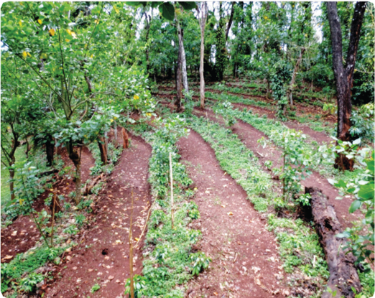
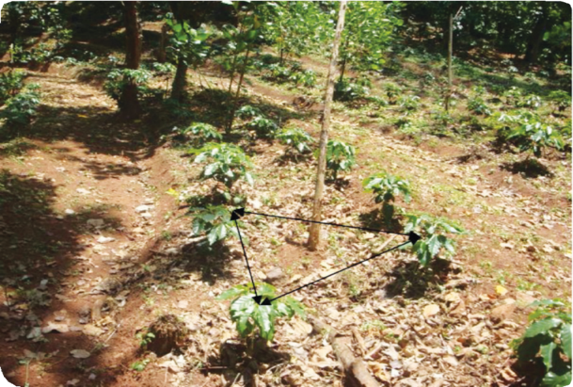
Contour planting
Contour row formation (Source: CCRI, India)
Triangular planting in contour rows (Source: CCRI, India)

Slide 7
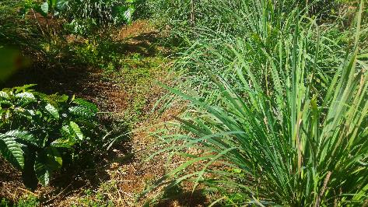
Soil binding grasses
Perennial grasses like lemongrass, vetiver are excellent soil binders in sloping lands
Soil binding grasses should be planted across the slope
They can be planted as complete rows or in strips in a zig-zag manner for every 5-10 coffee rows
Lemongrass and vetiver can also provide some additional income
Lemongrass bund in young coffee (Source: WASI, Vietnam)

Slide 8
Cover crops
In new plantation/ replating fields, the land is not fully covered.
Uncovered land is not only prone to erosion but also provides ideal conditions for weed growth
Growing of perennial creepers like wild peanut (Arachis pintoi) will provide effective ground cover to protect soil from erosion and also suppress weed growth
Wild peanut as cover crop (Source: WASI, Vietnam)

Slide 9
Importance of water conservation
Water is another critical input for coffee
The coffee growing areas receive a high rainfall, but experience pronounced wet and dry periods.
Lack of adequate soil moisture during the dry period affects critical growth stages like fruit maturation, ripening and formation of flower buds.
Thus it is important to adopt in situ moisture conservation
Coffee also requires water for flowering & fruiting. Normally rains trigger blossoming in coffee but delayed/ inadequate rains would significantly impact production
Hence, it is prudent to harvest the rainwater within the farm and utilise it for irrigation during flowering & fruiting. Timely irrigation increase the productivity of Robusta coffee by 50-90% over unirrigated fields.

Slide 10
Water conservation
Soil moisture conservation
Silt trap pits/ trenches
Green manure crops
Mulches
Rain water harvesting

Slide 11
Silt trap pits/ trenches
Silt trap pits/ trenches (30cm wide, 20 cm deep and 5-6 ft length) dug in between the coffee rows across the slope, in a staggered manner, are effective for preventing erosion and for in situ rain water harvesting
They are act as in situ compost pits for leaf litter and weed biomass
The pits/ trenches are dug immediately after cessation of rains and the soil is spread around the base of coffee bushes
Each year the pits/ trenches needs to be cleaned after the rains and the deposits spread around the base of the plants
Alternately, new trenches can be dug in separate spots once in 2-3 years

Slide 12
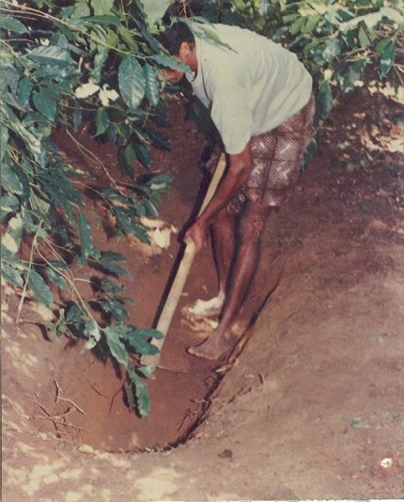
C |  | C |  | C |  | C |  | C |  | C |  | C |  | C |  | C |  | C
 | S |  |  |  | F |  |  |  | S |  |  |  | F |  |  |  | S
C |  | C |  | C |  | C |  | C |  | C |  | C |  | C |  | C |  | C
C |  | C |  | C |  | C |  | C |  | C |  | C |  | C |  | C |  | C
 | F |  |  |  | F |  |  |  | F |  |  |  | F |  |  |  | F
C |  | C |  | C |  | C |  | C |  | C |  | C |  | C |  | C |  | C
C |  | C |  | C |  | C |  | C |  | C |  | C |  | C |  | C |  | C
 | S |  |  |  | F |  |  |  | S |  |  |  | F |  |  |  | S
C |  | C |  | C |  | C |  | C |  | C |  | C |  | C |  | C |  | C
C |  | C |  | C |  | C |  | C |  | C |  | C |  | C |  | C |  | C
 | F |  |  |  | F |  |  |  | F |  |  |  | F |  |  |  | F
C |  | C |  | C |  | C |  | C |  | C |  | C |  | C |  | C |  | C
C |  | C |  | C |  | C |  | C |  | C |  | C |  | C |  | C |  | C
 | S |  |  |  | F |  |  |  | S |  |  |  | F |  |  |  | S
Trench in bet’n coffee rows (Source: CCRI, India)

Slide 13
Green manure crops
Leguminous crops like cow pea, horse gram can be grown during coffee establishment stage to provide ground cover
Sowing of these crops should be at the beginning of rainy season
After harvesting the crop, plough back the haulms to improve the soil organic matter content
The haulms can also be used as mulch around base of coffee plants to conserve soil moisture
Cow pea as cover crop (Source: CCRI, India)

Slide 14
Mulches
In newly planted fields mulching prevents soil erosion, conserves soil moisture and also suppresses weed growth
Stalks of millets, leaves of grasses like lemon grass, vetiver etc., which decay slowly are preferred as mulches
Mulches should be laid in between coffee rows along the contour lines
Leave a gap of about 1ft from the main stem of coffee to prevent attack of pests & diseases

Slide 15
Rain water harvesting
Notwithstanding high rainfall, the coffee areas suffer from shortage of water for estate operation like spraying, irrigation, processing etc.
Farm ponds/ open wells constructed at the lower end of the farm help in storage of rain water
The rain water within the farm can be channelled to the pond through a network of storm drains
The silt trap pits/ trenches dug across the slope are found to contribute towards recharging of ponds/ wells located at the down stream.

Slide 16
Terima kasih

